Slide 1
Open science and multiple hypothesis testing
Class 10
EDUC 265: Applied Regression Analysis
UCI School of Education

Slide 2
Plan for today
Research in crisis
(Open) science, credibility revolution
Multiple hypothesis testing

Slide 3
Research in crisis

Slide 4
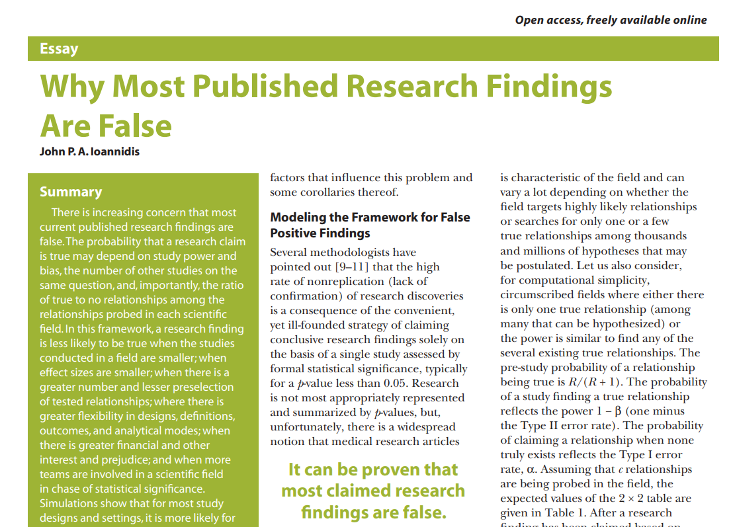
The replication crisis
Notes:
Open Science Collaboration 2015 sought to replicate 100 papers from top psych journals. Mean effect of replications was half that of originals
Medical studies funded by for profit sources more likely to have +ve effects than nonprofit research

Slide 5
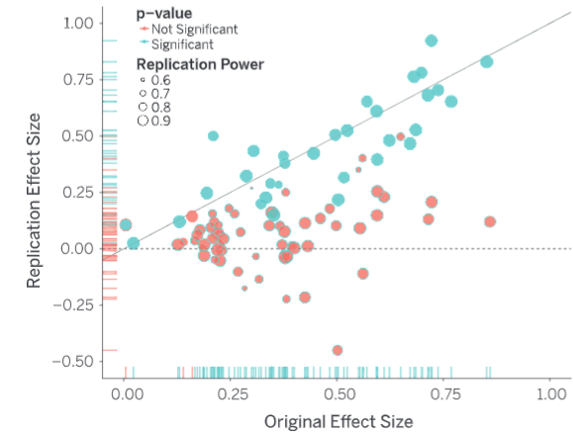
The replication crisis in psychology
Open Science Collaboration, 2015
Notes:
Open Science Collaboration 2015 sought to replicate 100 papers from top psych journals. Mean effect of replications was half that of originals
Medical studies funded by for profit sources more likely to have +ve effects than nonprofit research

Slide 6
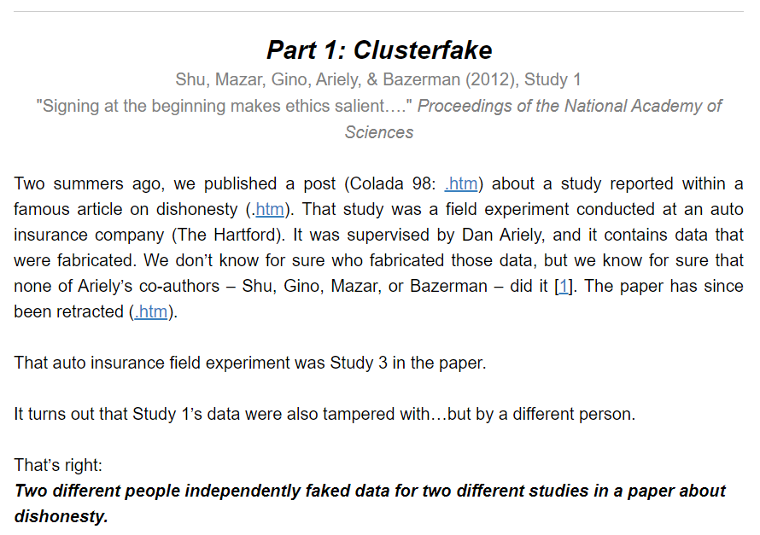
Fraud* in psychology *ahem, don’t sue me, just “misconduct”, and a“significant violation of academic integrity”
Data Colada, 2023
Notes:
https://datacolada.org/109

Slide 7
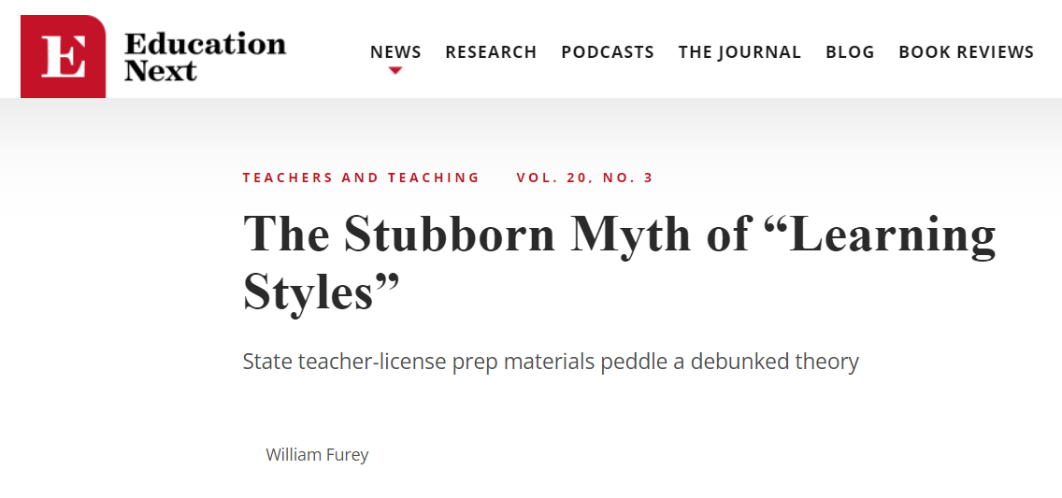
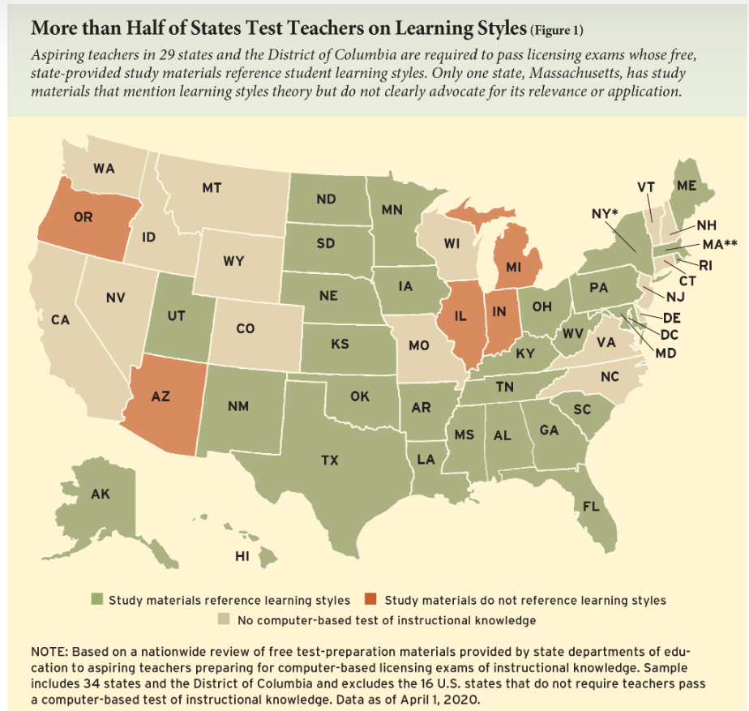
Sticky junk science in education
Notes:
https://www.educationnext.org/stubborn-myth-learning-styles-state-teacher-license-prep-materials-debunked-theory/

Slide 8
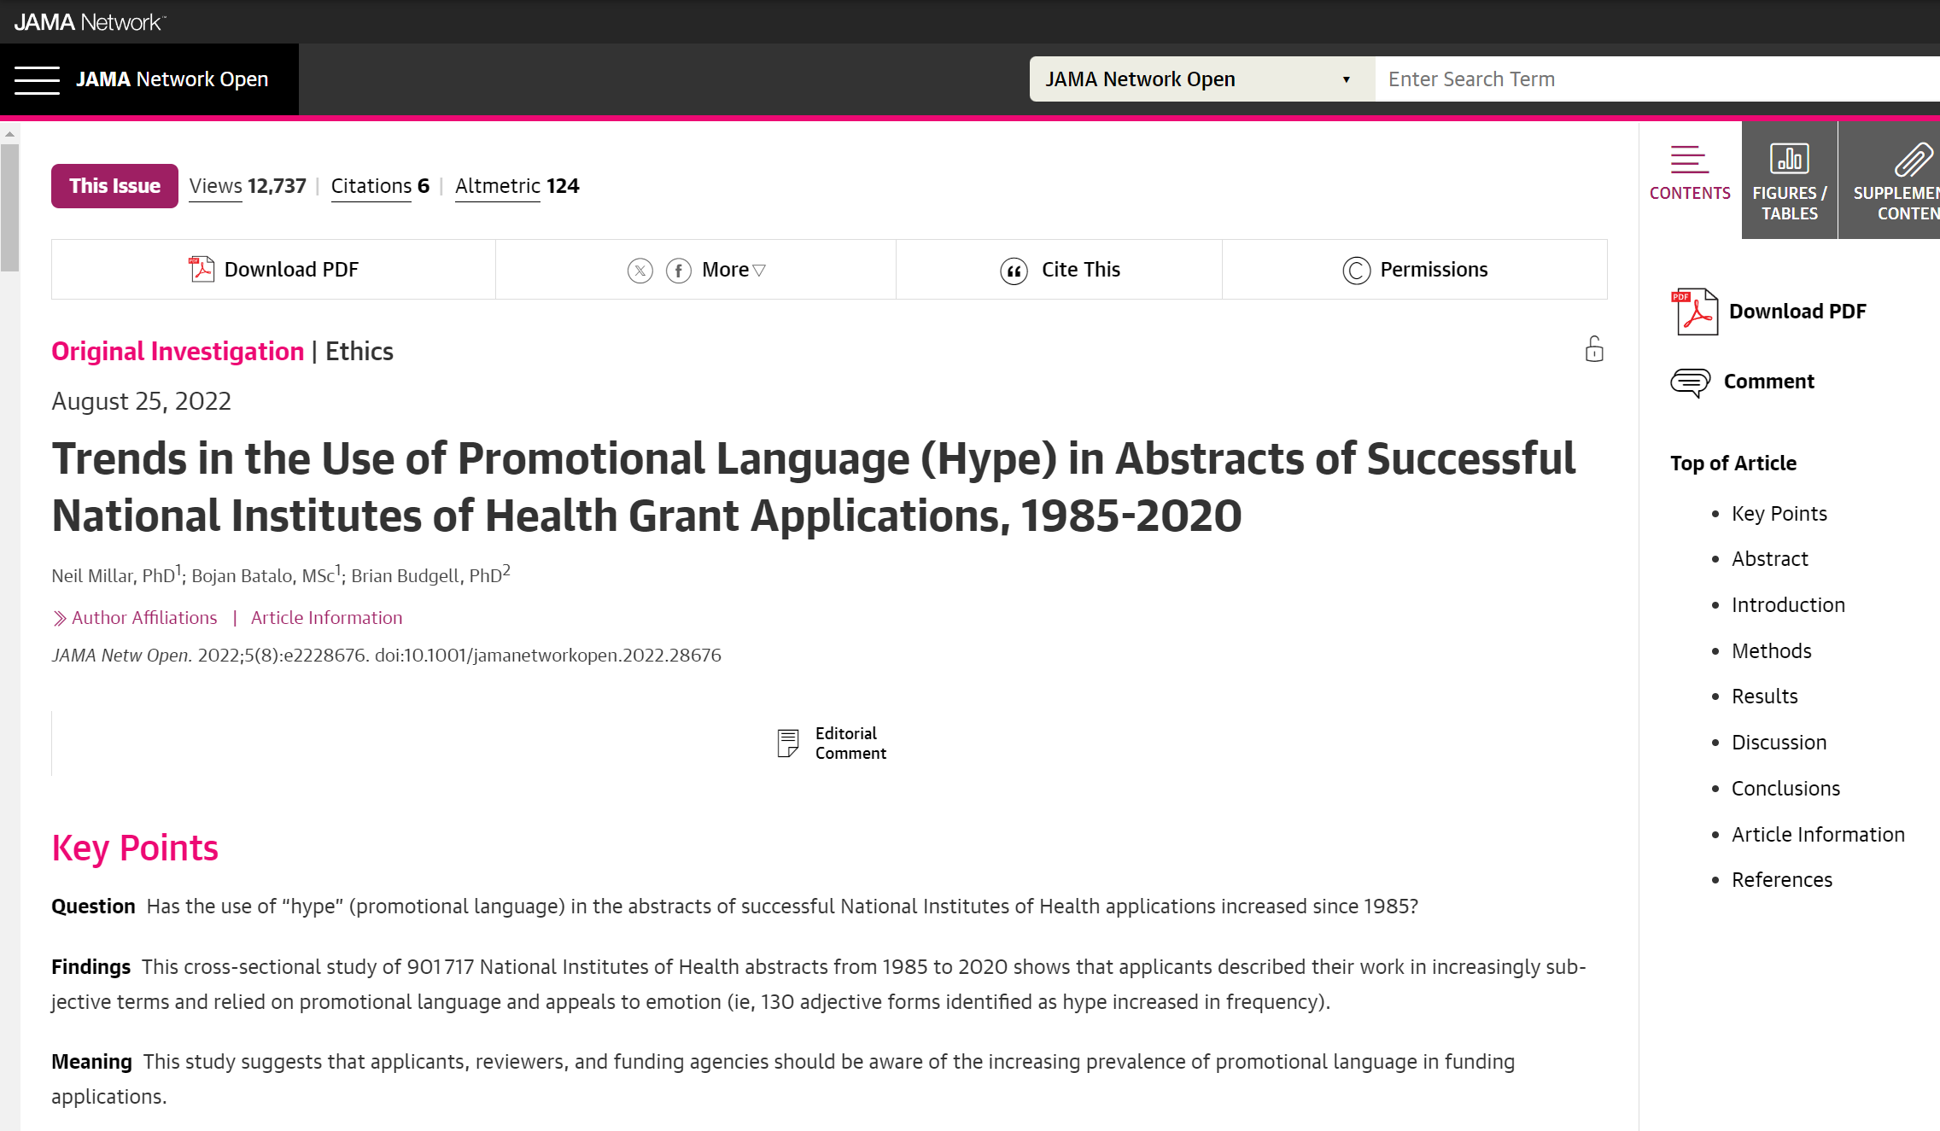
The hype hype is real
Millar et al. 2022

Slide 9
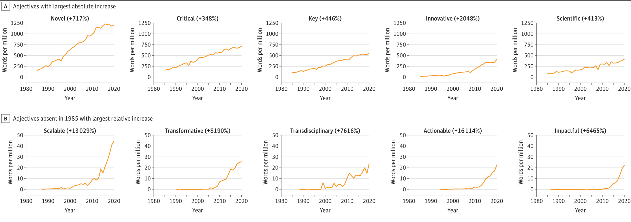
The hype hype is real
Millar et al. 2022

Slide 10
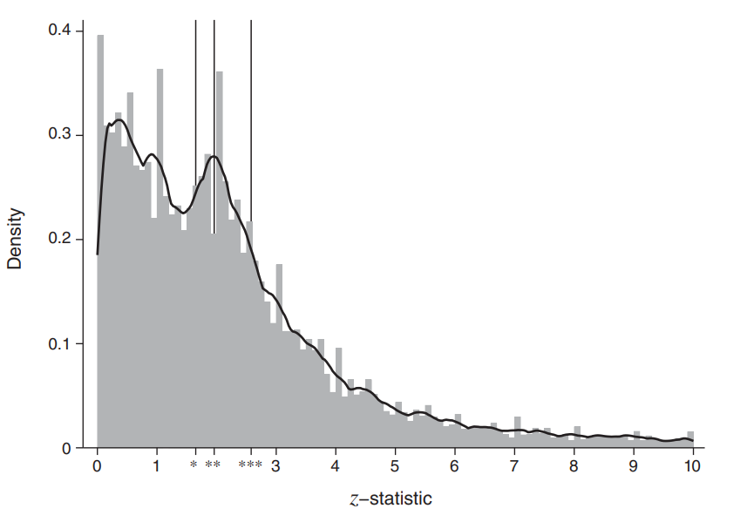
p-hacking, publication bias in economics
Brodeur et al. 2020

Slide 11
Underpowered studies publish big effects
de Barros et al. 2023
Notes:
Andreas de Barros, Johanna Fajardo-Gonzalez, Paul Glewwe, Ashwini Sankar, The Limitations of Activity-Based Instruction to Improve the Productivity of Schooling, The Economic Journal, 2023;, uead099, https://doi.org/10.1093/ej/uead099

Slide 12
A few explanations (not excuses)
Publish or perish, incentives for fishing, p-hacking
Beliefs, preferences, push for “anything goes”
Small-sample, under-powered studies
Novelty counts, hype gets rewarded
No incentives for good practices
“Researcher degrees of freedom”

Slide 13
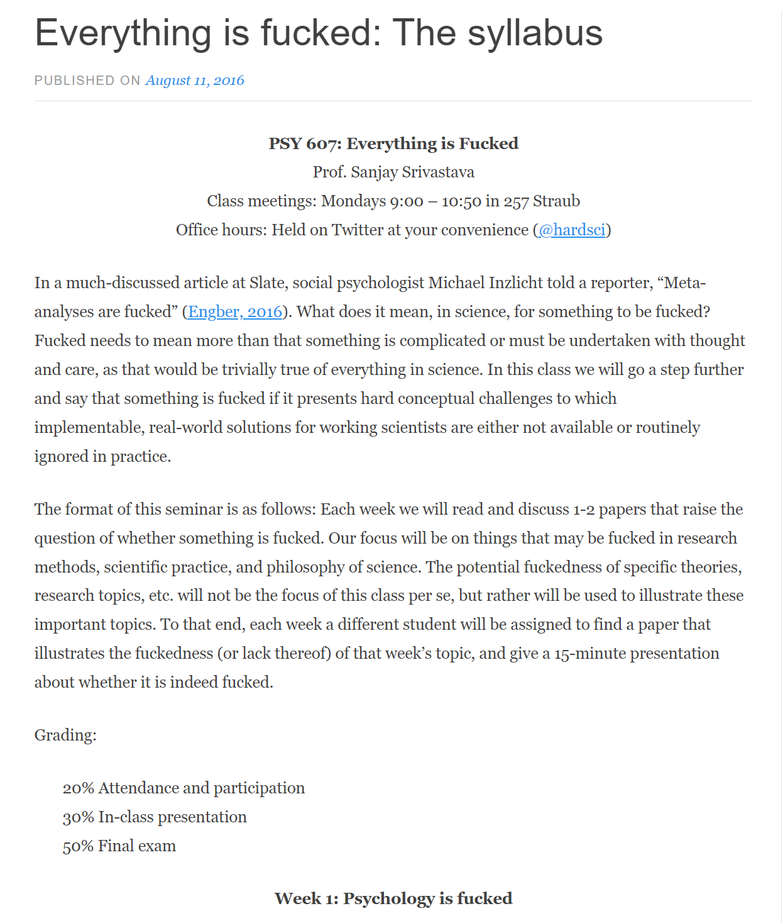
One way to look at it
Notes:
Prof. Sanjay Srivastava (The Personality and Social Dynamics Lab, The University of Oregon) https://thehardestscience.com/2016/08/11/everything-is-fucked-the-syllabus/

Slide 14
(Open) science, credibility revolution

Slide 15
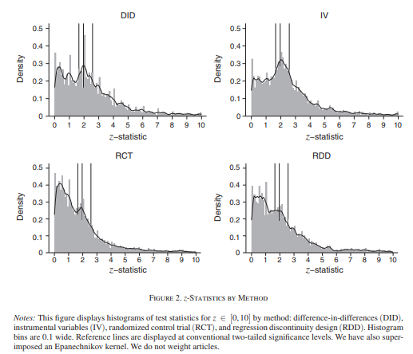
p-hacking is less common in RCTs…
Brodeur et al. 2020

Slide 16
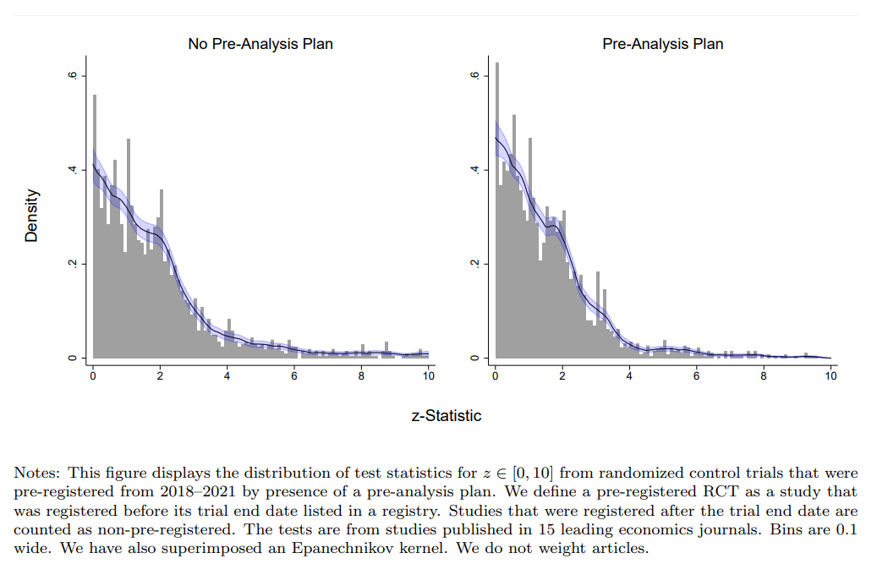
…and less common with pre-analysis plans
Brodeur et al. 2023
Notes:
https://docs.iza.org/dp15476.pdf

Slide 17
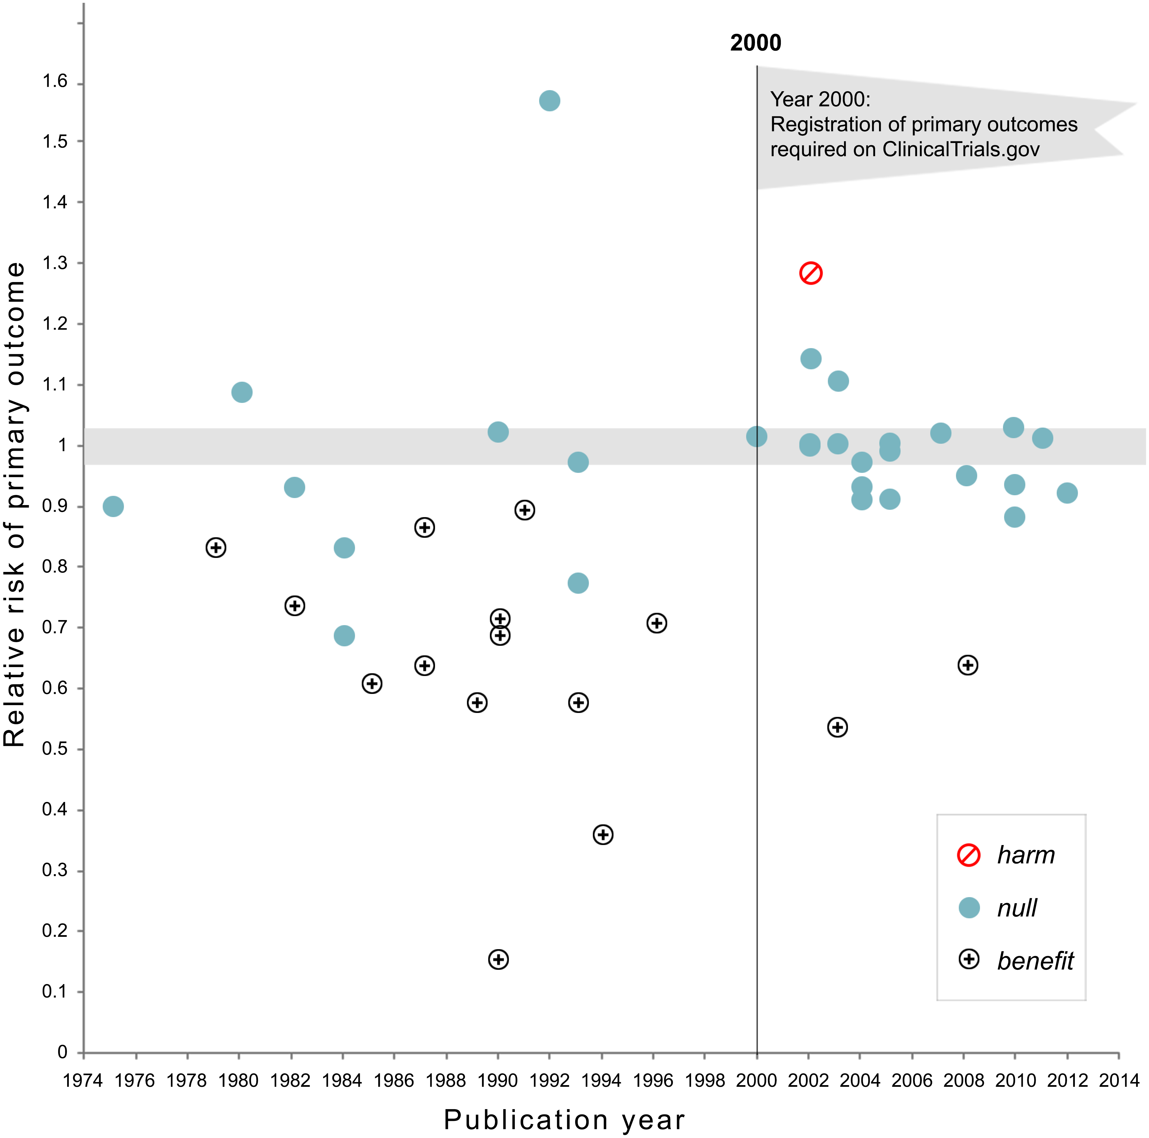
Medicine shows mandatory registration helps
Kaplan & Irvin 2015
Notes:
https://journals.plos.org/plosone/article?id=10.1371/journal.pone.0132382#

Slide 18

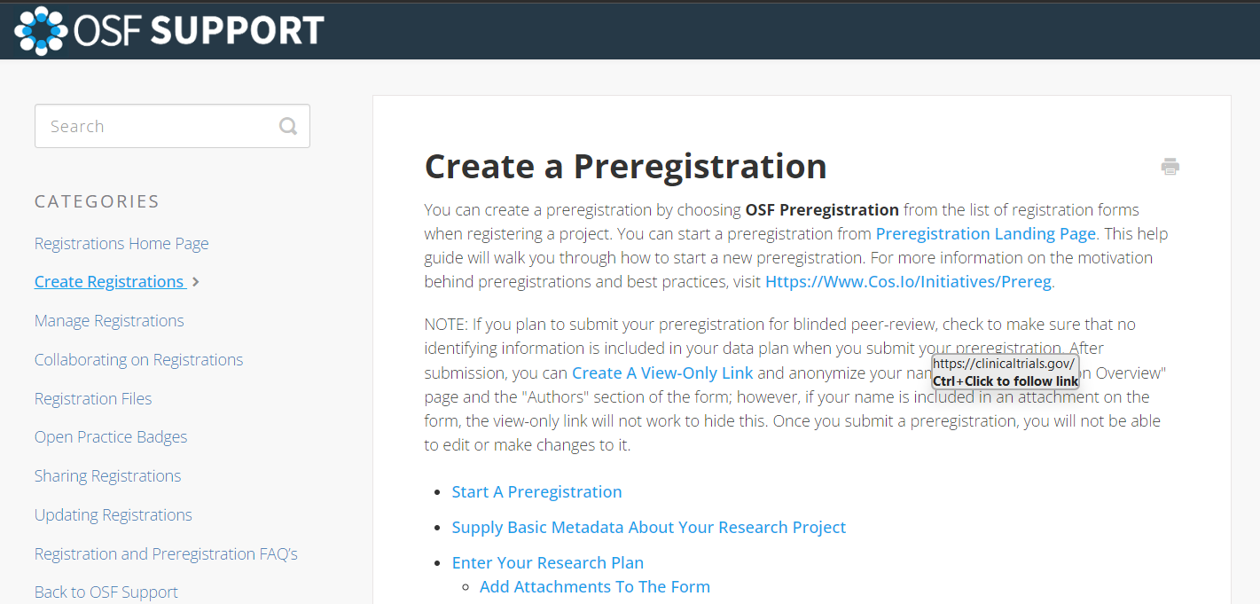
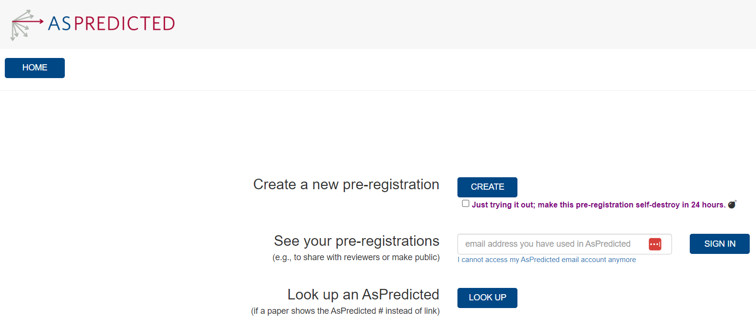
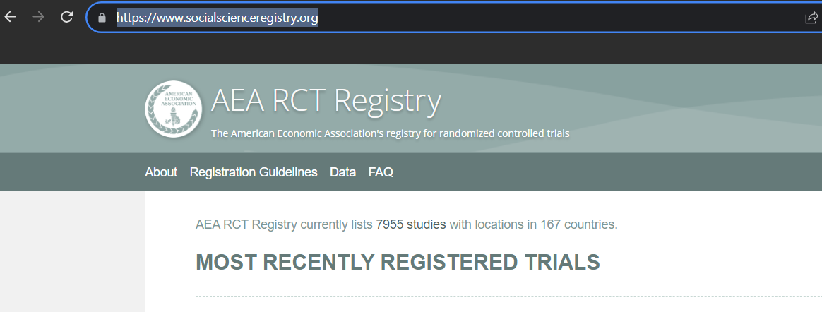
So, register your study …
Notes:
https://docs.iza.org/dp15476.pdf

Slide 19
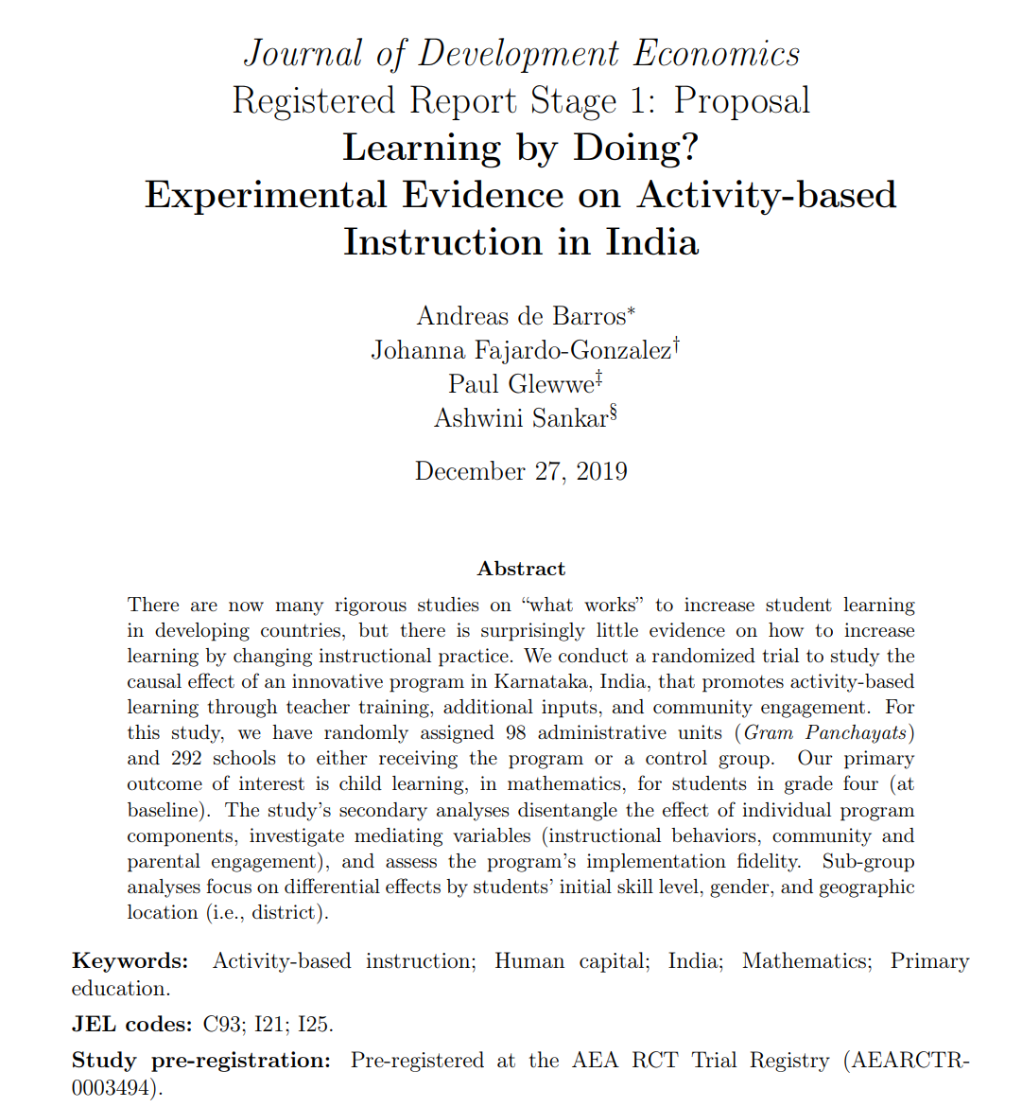
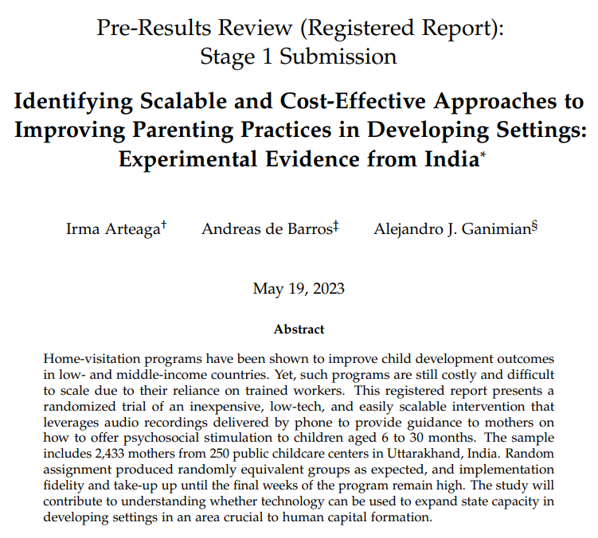
… with a pre-analysis plan / registered report

Slide 20
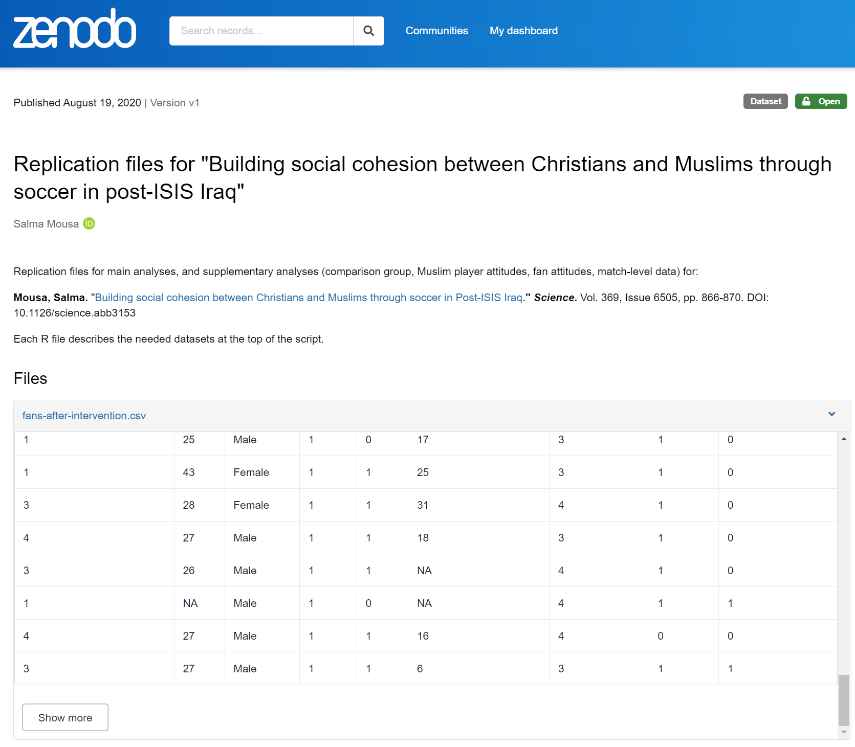
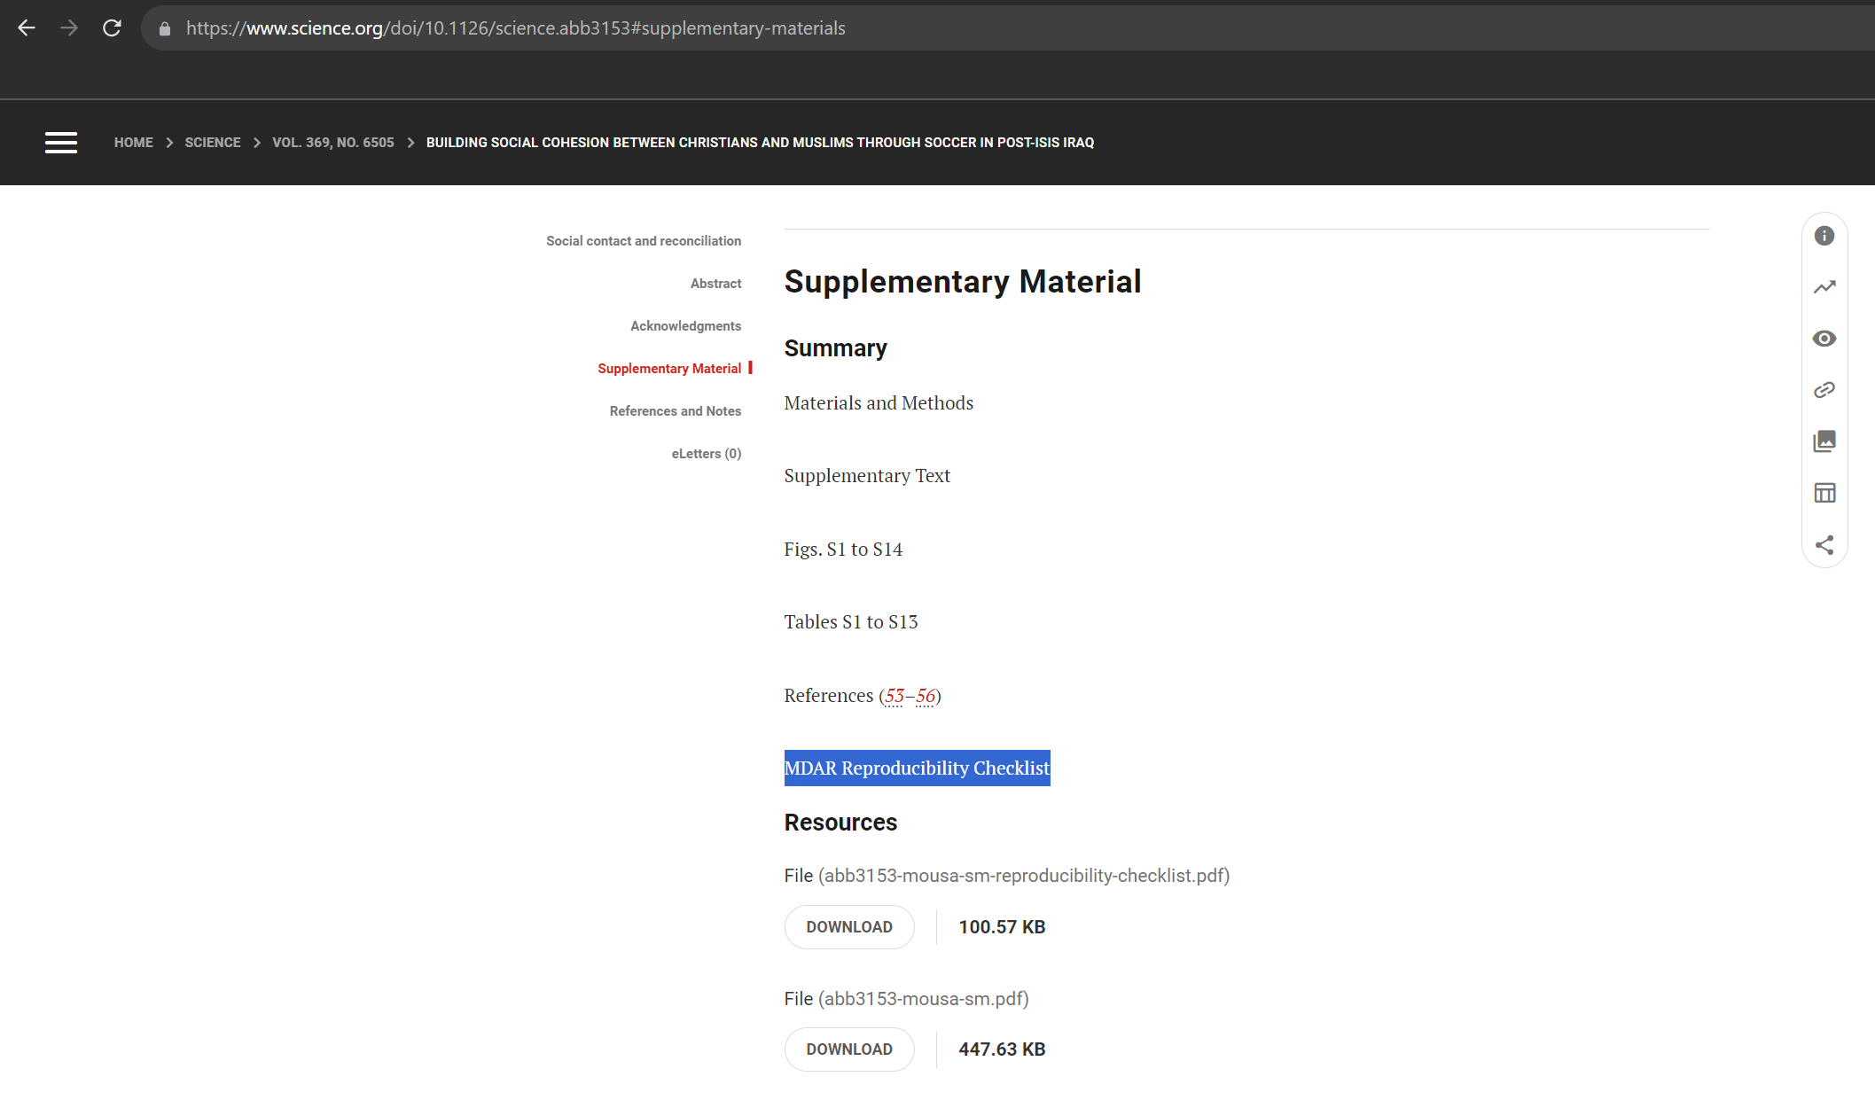
Make sure your study is replicable, accessible
Notes:
https://www.science.org/doi/10.1126/science.abb3153#supplementary-materials
https://zenodo.org/records/3942437

Slide 21
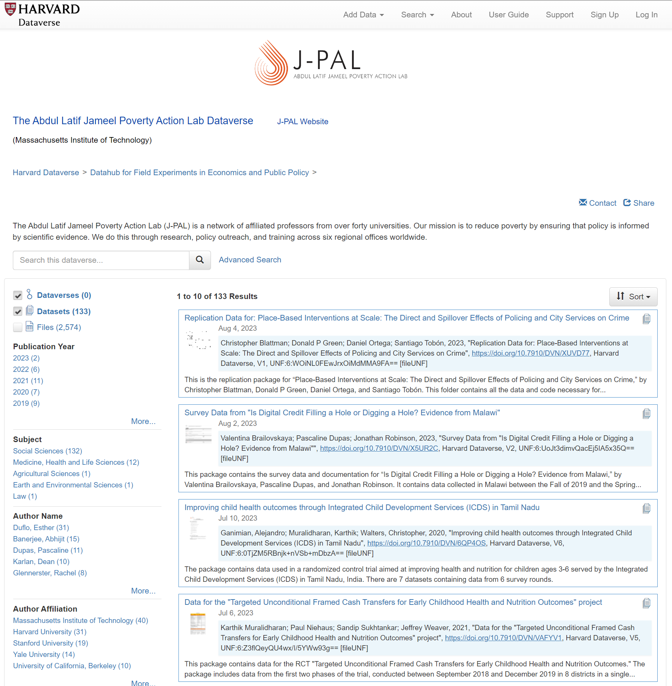
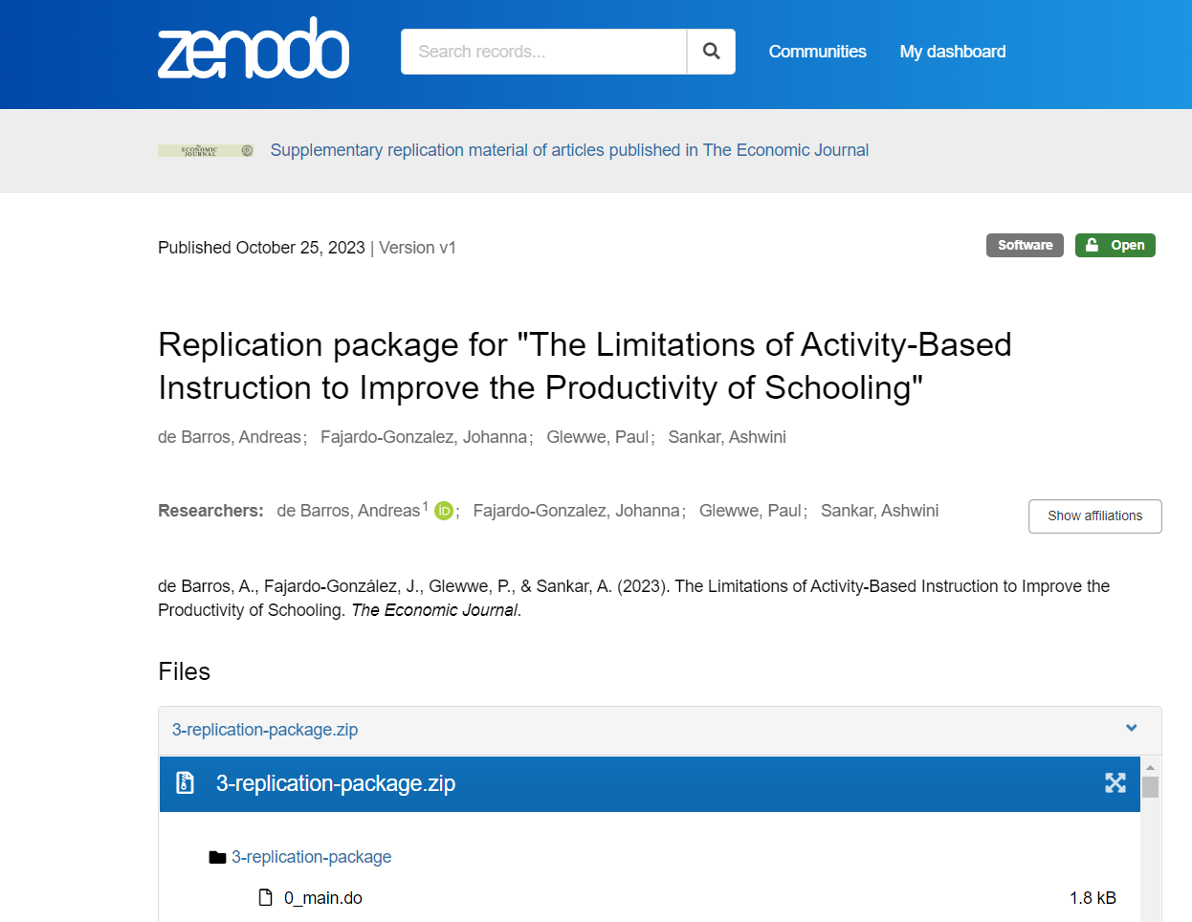
Make use of accessible data, replicate, extend
Notes:
https://zenodo.org/records/10038843

Slide 22
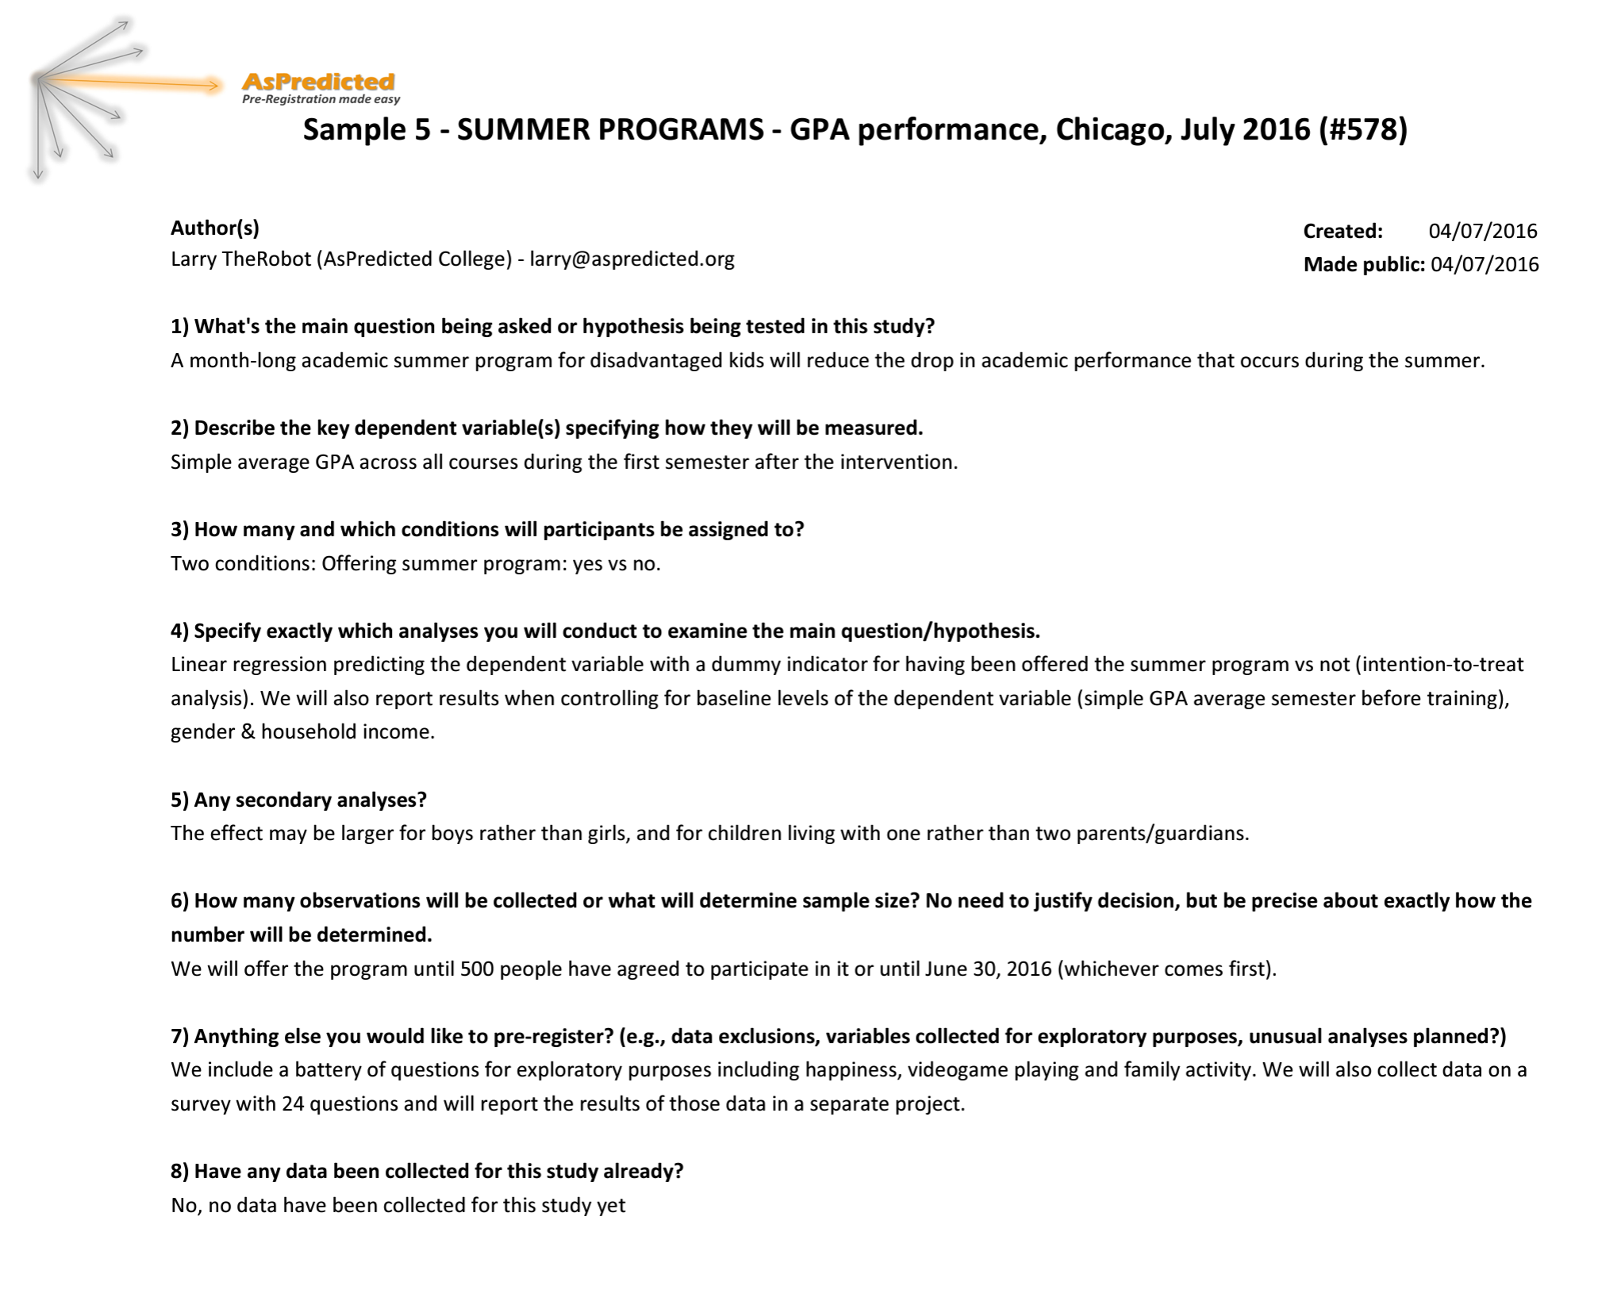
I do, we do, you do
Notes:
https://zenodo.org/records/10038843

Slide 23
Multiple hypothesis testing

Slide 24
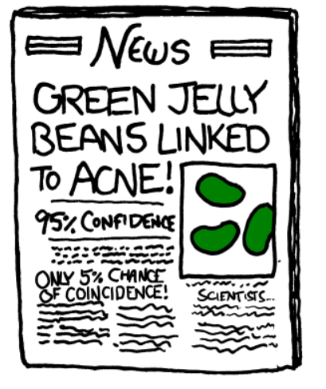
Notes:
https://xkcd.com/882/

Slide 25
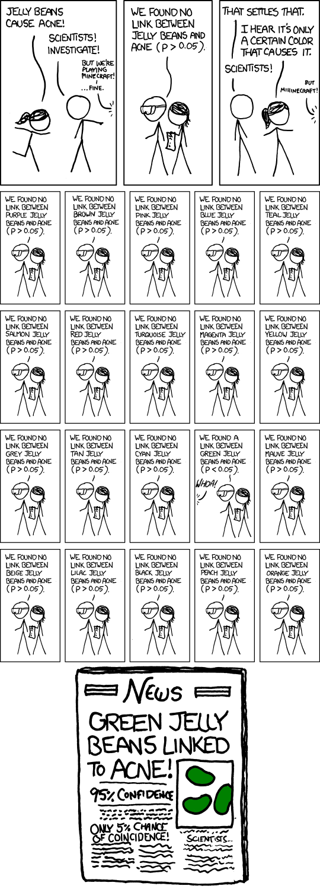

Slide 26
Review of “statistical significance”
Alpha = 0.05 Even if there is no effect, we may falsely conclude that there is one in 5% of the studies (1 out of 20). “That’s fine.”

Slide 27
Jelly beans in education research
“This program is effective for low-performing girls”

Slide 28
Jelly beans in education research
“Collaborative learning, defined as courses with at least a discussion forum and one group assignment, is effective”

Slide 29
Jelly beans in education research
“This intervention improved students’ geometry skills.”

Slide 30
Solutions
Control the error rate (FWER), false discovery rate (FDR), or simulate
Use an outcome index
Pre-register, write registered reports

Slide 31
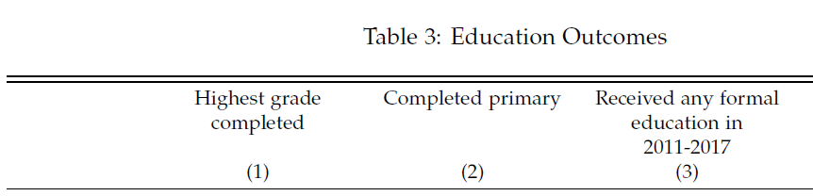
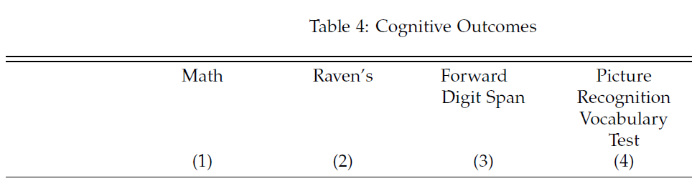
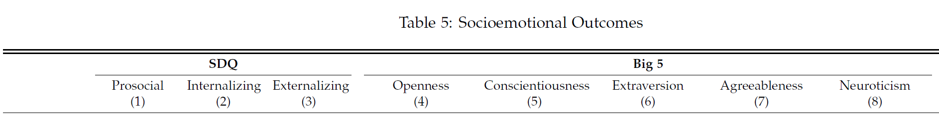
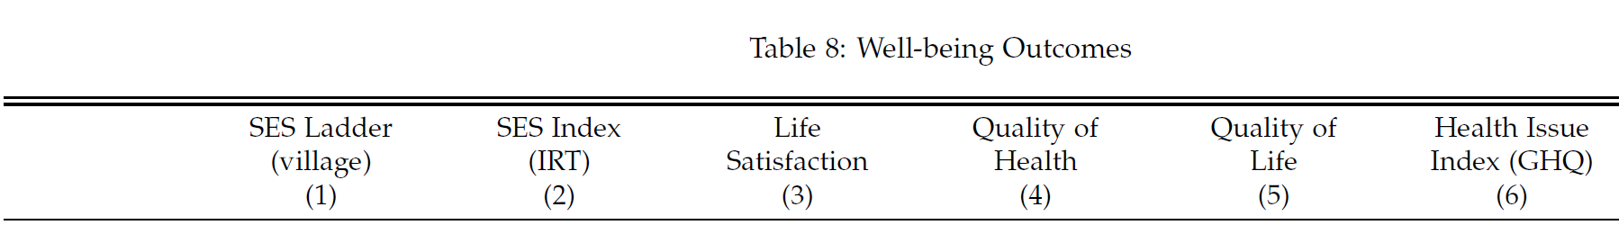
How’s life? Tell me, how’s what’s your family?
Barrera-Osorio et al. 2023
Notes:
https://onlinelibrary.wiley.com/doi/pdf/10.1002/pam.22533

Slide 32
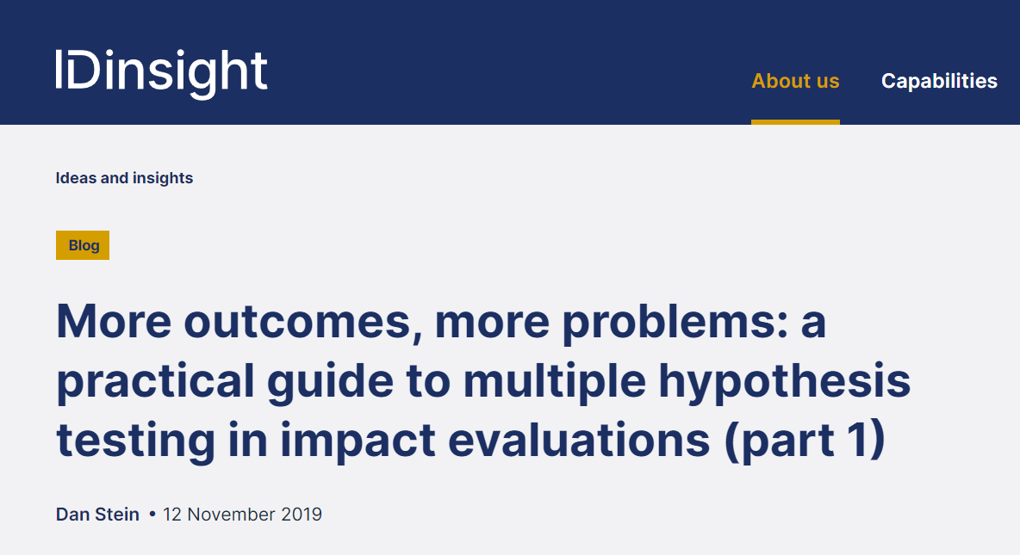
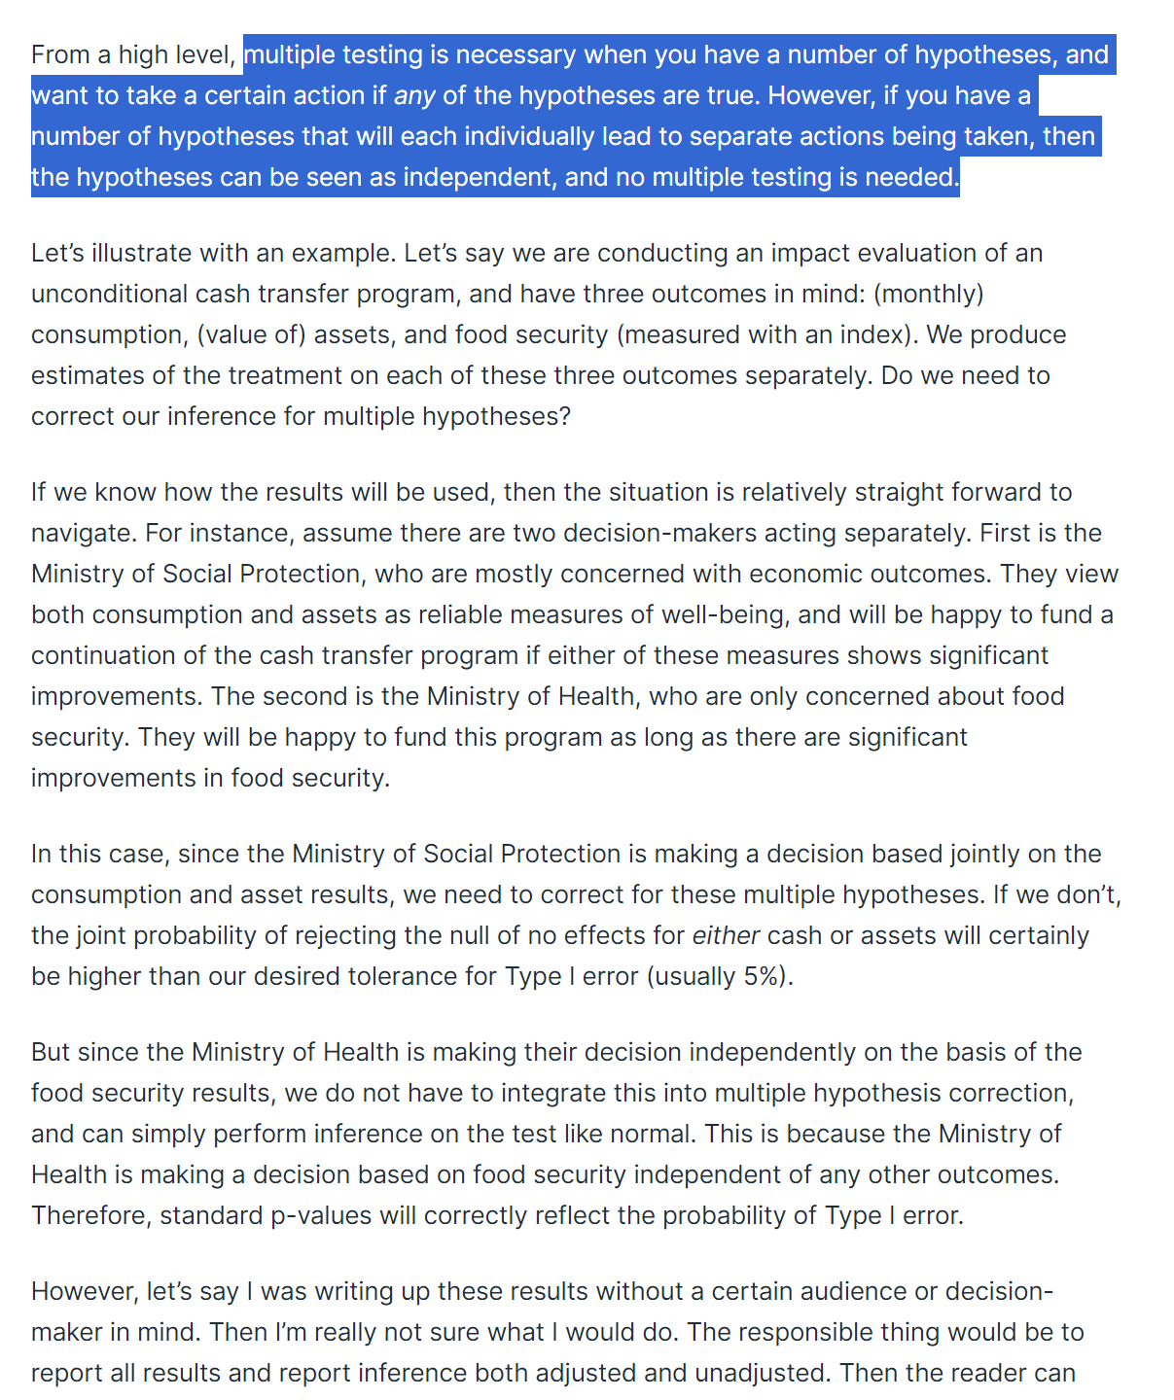
Notes:
https://onlinelibrary.wiley.com/doi/pdf/10.1002/pam.22533

Slide 33
FDR vs. FWER (also, thank you, ChatGPT)
FDR (False Discovery Rate control) is like checking how many mistakes you make among the toys you pick to play with. For example, if you have many toys and you want to find all the red ones, FDR helps you make sure you don't say something is red when it's actually not.
FWER (Family-Wise Error Rate control) is a bit stricter. It's like making sure you don't make any mistakes at all while picking toys. So, if you're super careful about only saying a toy is red when you're absolutely sure, that's like FWER.

Slide 34
FWER: The Bonferroni method
alpha* = alpha / number of tests

Slide 35
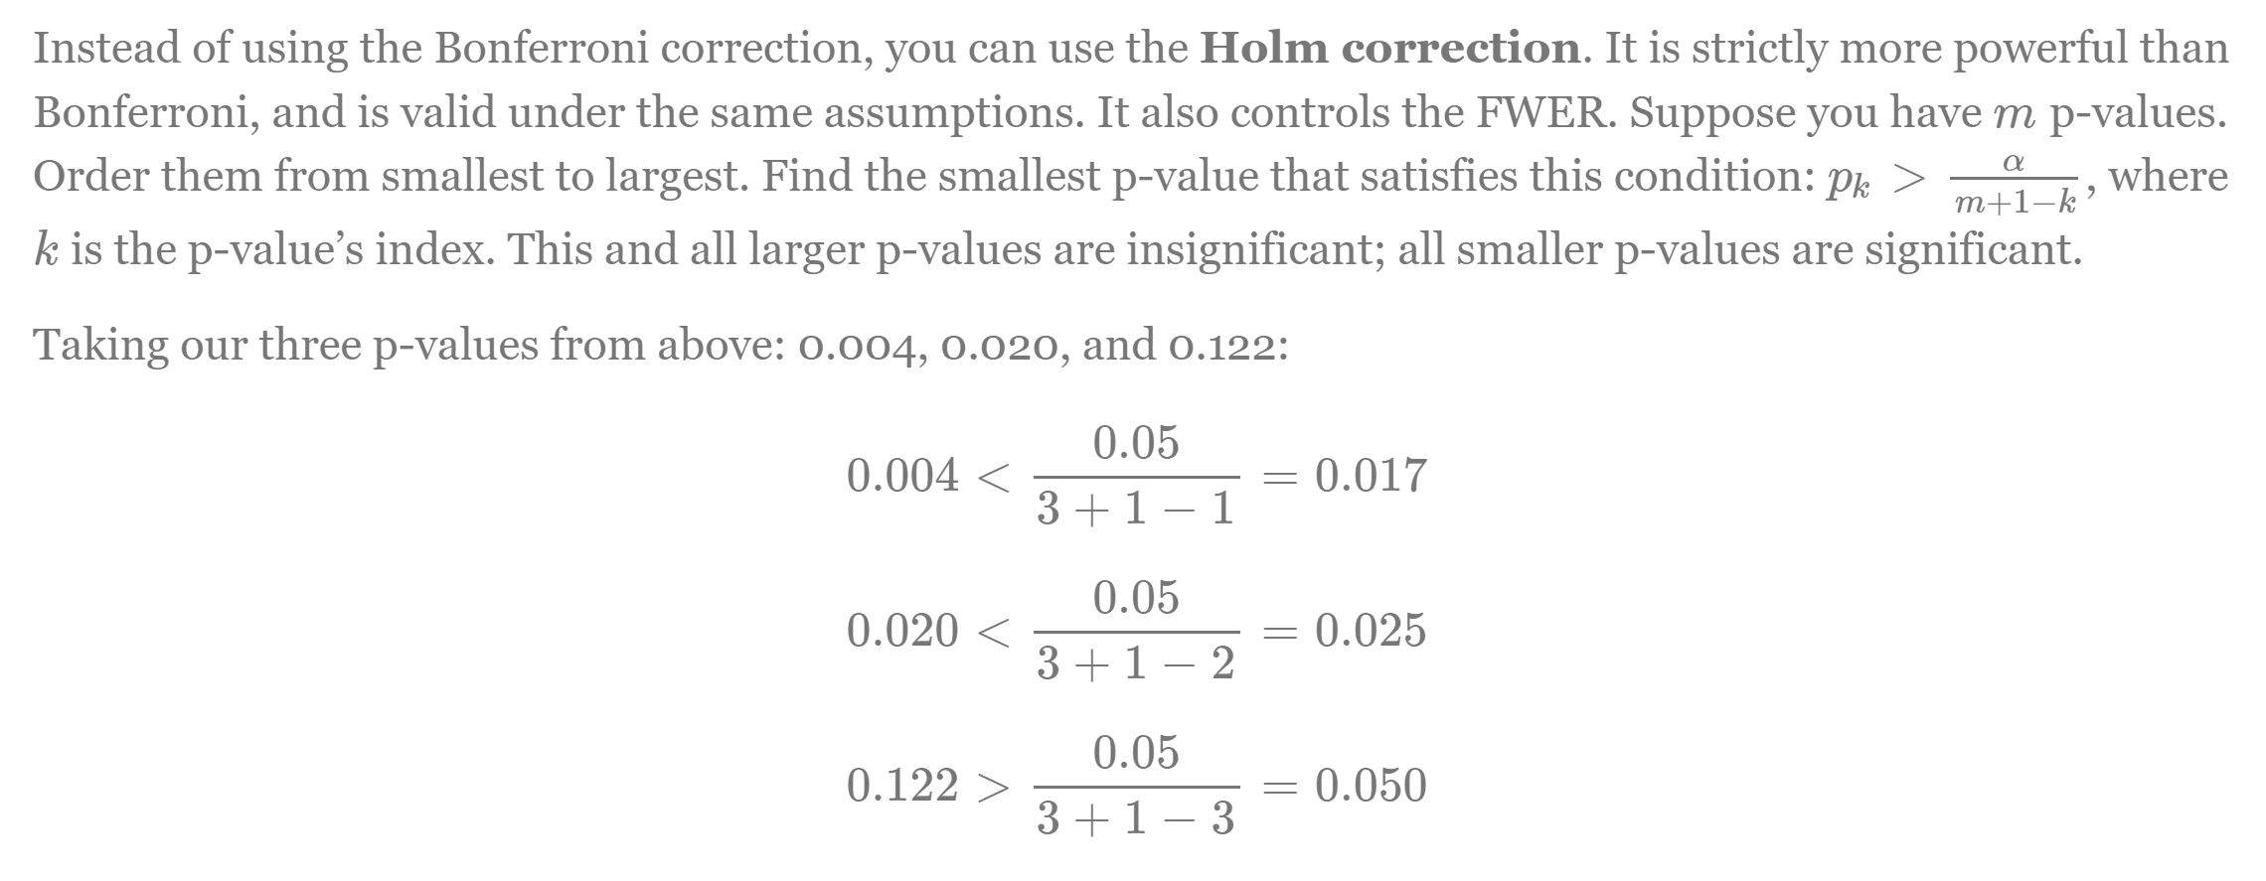
FWER: Holm correction
This week’s reading by EGAP

Slide 36
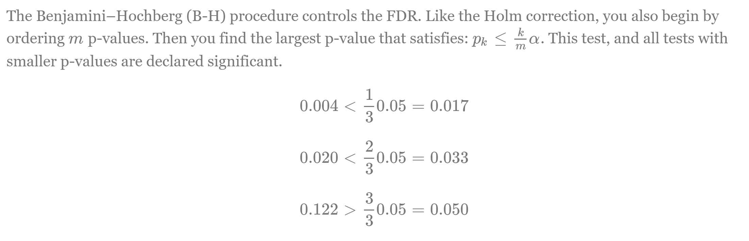
FDR: The Benjamini-Hochberg procedure
This week’s reading by EGAP

Slide 37
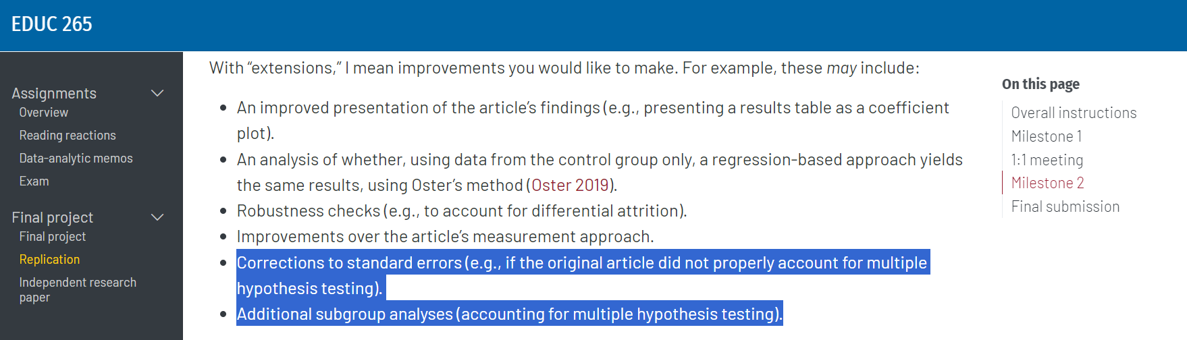
Using mult. hypothesis testing adjustments

Slide 38
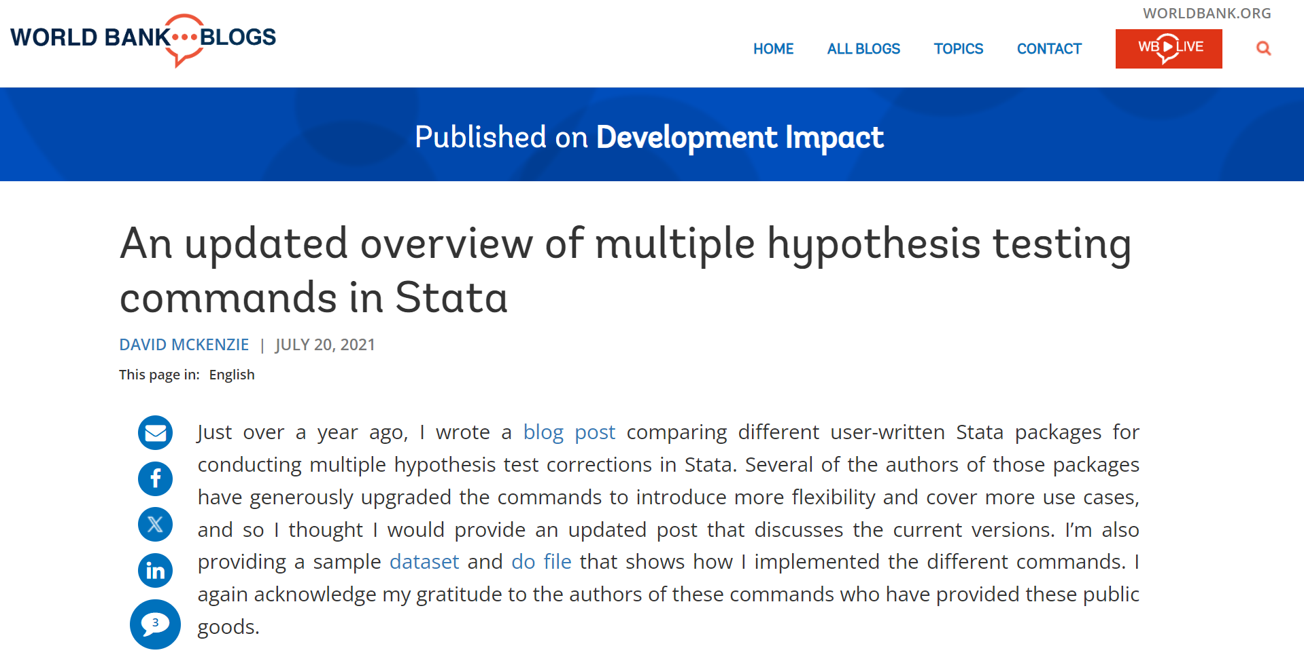
Using mult. hypothesis testing adjustments

Slide 39

Reducing the number of tests with indices
Mean
Mean effects index
Inverse covariance matrix weighted average
Item Response Theory (IRT)
Factor analysis
Principal Component Analysis (PCA)

Slide 40
How’s life? Tell me, how’s what’s your family?

Slide 41
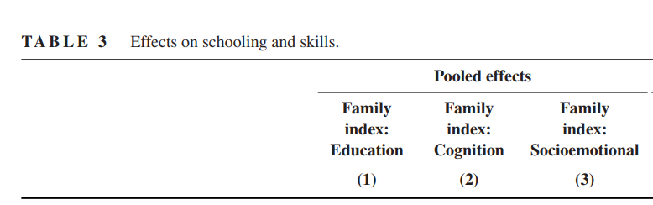
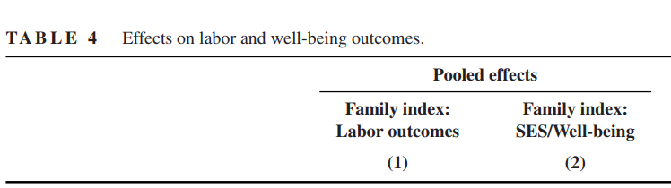
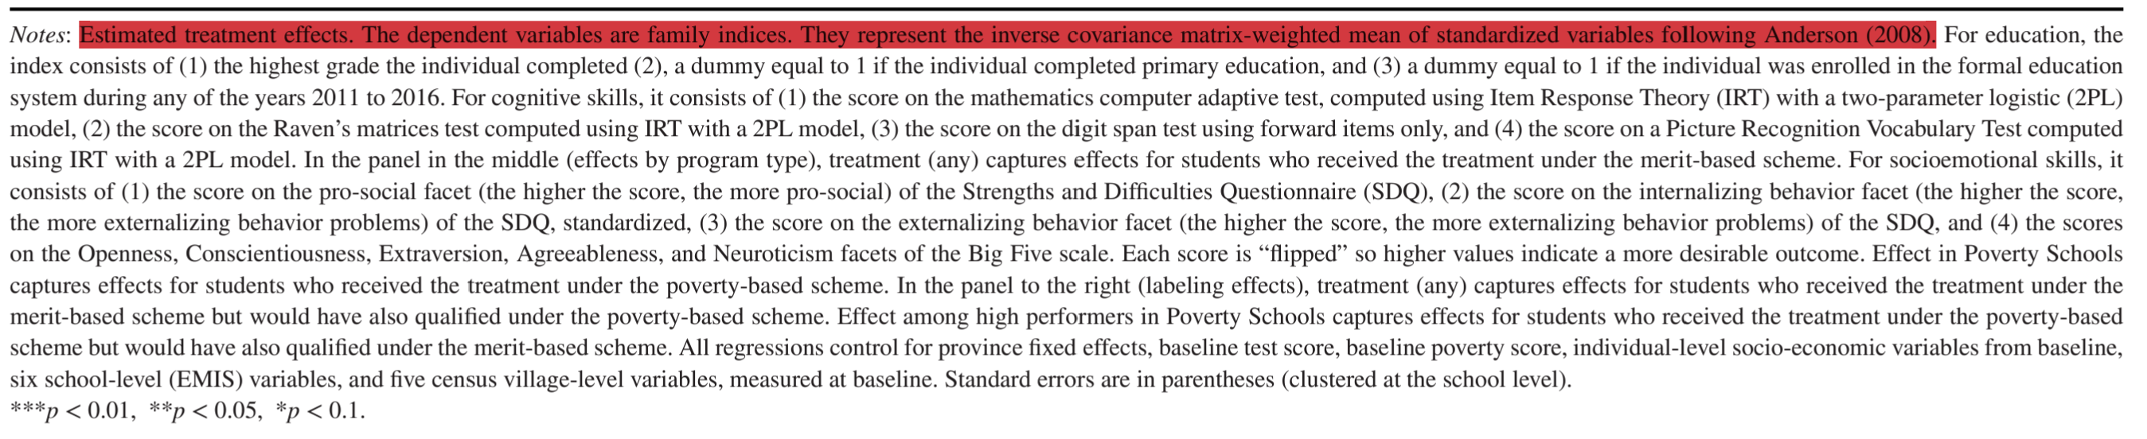
Reducing the number of tests with indices

Slide 42
Final steps
Final projects
Due on March, 22 (Friday)
Today’s lab
Workshop, voluntary
EEE Feedback
Due tomorrow

